Slide 1
Course Capstone Project Proposal Title: Design and Implementation of an Arduino-Based Flame Detection System with LED Alert, Servo-Driven Water Control, Wireless Communication, and OLED Display
Course Code: | EEE 4103 | Course Name: | Microprocessor and Embedded Systems
Course Teacher: Prof. Dr. Engr. Muhibul Haque Bhuyan
Professor
Department of Electrical and Electronic Engineering
SL # | Students ID | Students Name | Program | Section
1 | 23-51730-2 | Md Shahriar Haque | BSc in CSE | I
2 | 23-52807-2 | Sadia Tasnim | BSc in CSE | I
3 | 22-48321-3 | Sharan Dip Sarker | BSc in CSE | I
4 | 22-48553-3 | Subita Binta Hasib Anonna | BSc in EEE | I
5 | 22-48744-3 | Rakib Hossain | BSc in EEE | I

Slide 2

Outline of the Presentation
Aims and Objectives
Introduction
Literature Review
Research/Working Method
Description of the Work
Survey Report
Gantt Chart
Results, Outcomes, and Discussions
Conclusions (1 slide)
Future Works (1 slide)

Slide 3
Aims and Objectives of the Work
To develop a flame detection system using Arduino for real-time monitoring.
To implement an LED alert and servo-controlled water mechanism for immediate fire response.
To incorporate wireless communication and an OLED display for remote monitoring and status visualization.
To analyze sensor data for accurate flame detection and system responsiveness.
To design an efficient hardware and software interface for integrated flame control.
To simulate system behavior under various flame conditions before deployment.
To test the system for reliability, accuracy, and timely response to fire events.
To validate the performance of the flame detection and suppression system in real-world scenarios.

Slide 4
.
Introduction
Background Information
Fire hazards are a major threat to life and property, especially in densely populated areas.
Traditional fire detection systems are often expensive and lack real-time control.
Arduino-based systems offer low-cost, customizable solutions for safety automation.
Integration of sensors, displays, and wireless modules enables smarter fire response.
Embedded systems are increasingly used in home automation and safety applications.
Motivation
To enhance safety by providing a fast-response flame detection system.
To automate fire suppression using servo-driven water control, minimizing human intervention.
To enable remote monitoring through wireless communication and OLED display feedback.
To develop a cost-effective and scalable solution suitable for homes, labs, and small industries.

Slide 5
Introduction
Why This Work Matters:
Improves upon previous systems by adding Bluetooth, display, and manual override.
Offers real-time feedback and control—missing in many low-cost fire detection setups.
Contributes to safer, smarter, and more connected environments.

Slide 6
Literature Review
Wireless Communication in Fire Detection Systems
Previous Work: Le et al. (2022) presented a communication and control system for remotely operated underwater vehicles, utilizing wireless communication for data transmission.
Limitation: The focus was on underwater vehicles, not on fire detection systems, and did not address fire suppression.
Our Contribution: We implement wireless communication in a fire detection system, allowing remote monitoring and control of fire suppression mechanisms.
Servo-Driven Water Control in Fire Suppression Systems
Previous Work: Wu & Karray (2014) developed a water level control system utilizing a servo motor, valves, a pump, an infrared sensor, and a DSP controller.
Limitation: The system was designed for water level control and did not address real-time fire suppression or detection.
Our Contribution: We integrate a servo-driven water control mechanism with an Arduino-based flame detection system, enabling automated fire suppression in real-time.

Slide 7
Literature Review
Basic Flame Detection with LED Indicators
Previous Work: Instructables (2015) demonstrated a simple Arduino-based fire alarm system using a flame sensor, LED, and buzzer to indicate flame presence.
Limitation: The system lacks automated fire suppression mechanisms and remote monitoring capabilities.
Our Contribution: Integrates servo-driven water control for automatic suppression and wireless communication for remote alerts, enhancing safety and responsiveness.
An Autonomous Arduino-based Firefighting Robot for Laboratory Environments
Previous Work:Sharma et al. (2021) developed an Arduino-based autonomous firefighting robot using flame sensors, PIR sensors, and servo-controlled water spray.
Limitation:The system performed well indoors but had poor obstacle avoidance and reduced flame detection accuracy under bright lighting.
Our Contribution:Our project enhances usability with keypad input, OLED feedback, and Bluetooth control—features not present in Sharma et al.'s design.

Slide 8
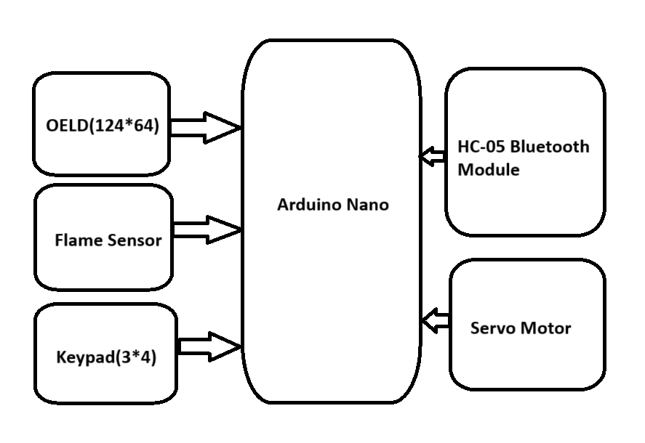
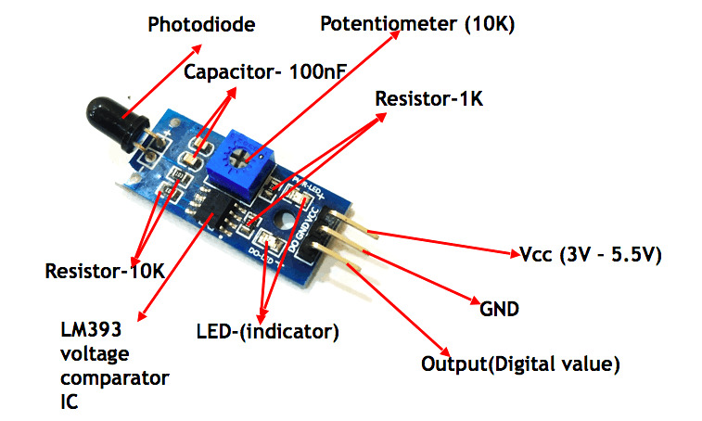

Research/Working Method
Overall Flow:
Flame → Flame Sensor → Arduino → OLED/LED Display → Servo Motor & Bluetooth Alert → User Interaction via Keypad
Flame Detection:
The flame sensor continuously monitors the environment for fire.
When flame is detected, it sends a signal to the Arduino Nano.
Signal Processing & Display:
The Arduino Nano processes the signal.
The status is shown on the OLED display (128x64) in real-time.
Block diagram of the system

Slide 9
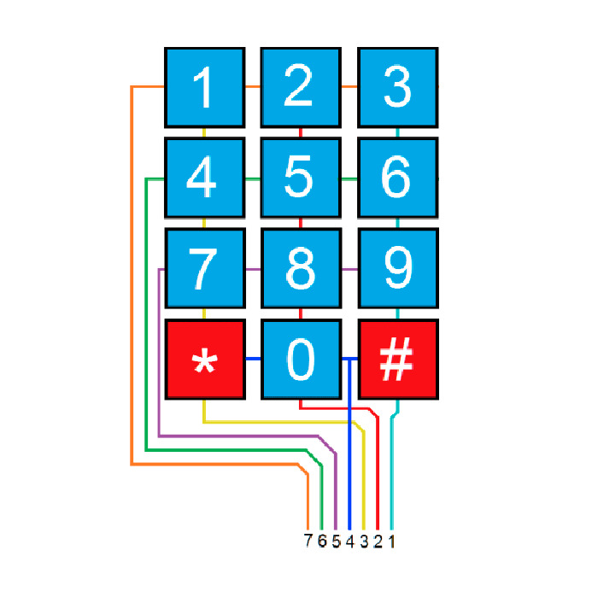
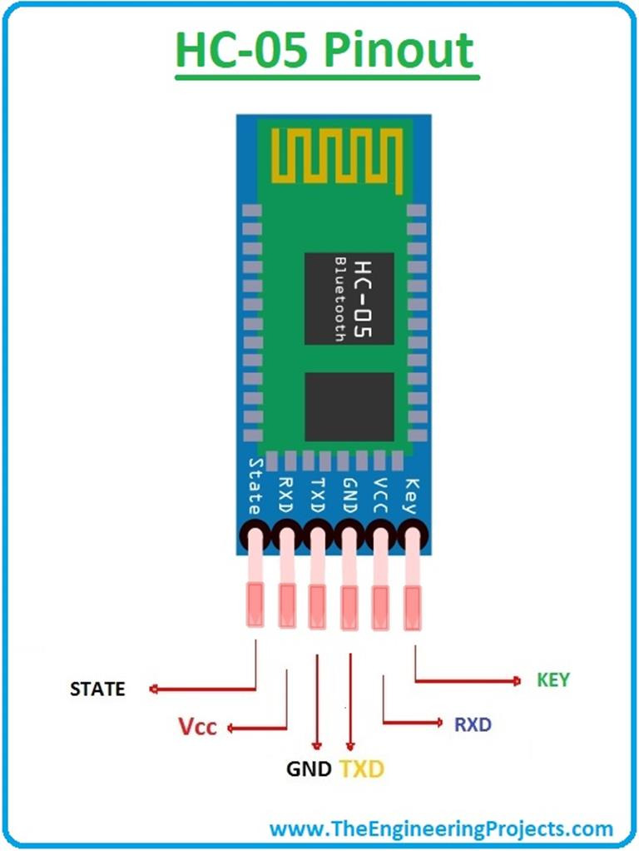
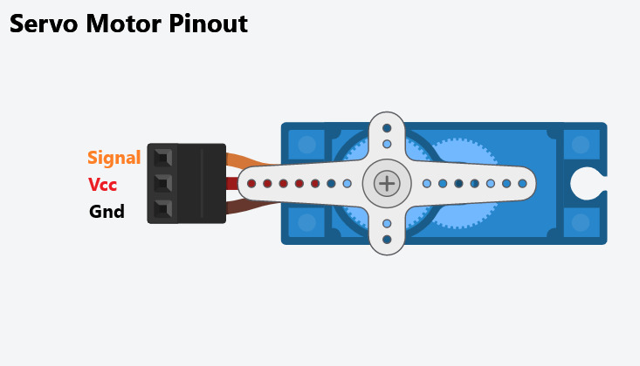
Research/Working Method
User Interaction:
Keypad (3x4) allows the user to input commands, e.g., arm/disarm the system or manually trigger the water suppression.
Wireless Communication:
HC-05 Bluetooth module sends the detection status to a mobile device or computer for remote monitoring.
Alert & Suppression:
LED alert indicates fire detection locally.
Servo motor drives a water valve to suppress the fire automatically.

Slide 10
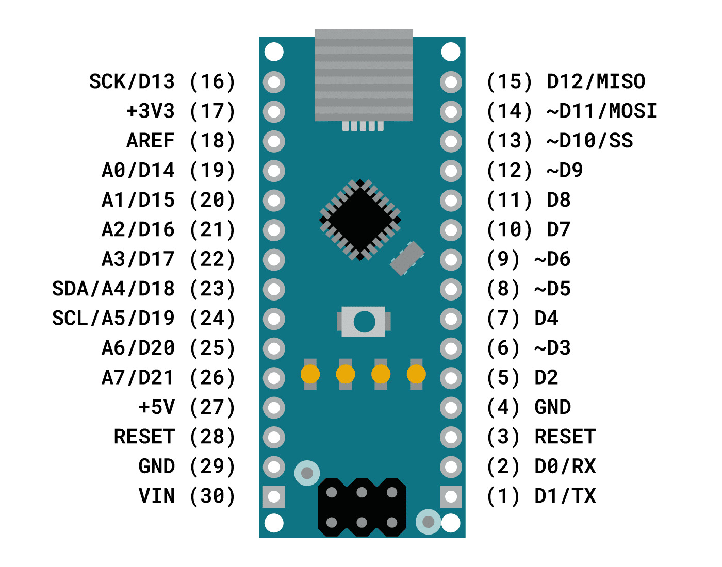
Research/Working Method
Arduino Nano processes input signals from sensors, executes programmed instructions, and controls output devices like motors or displays.
It is small, low-cost, easy to program, and suitable for compact embedded projects.

Slide 11
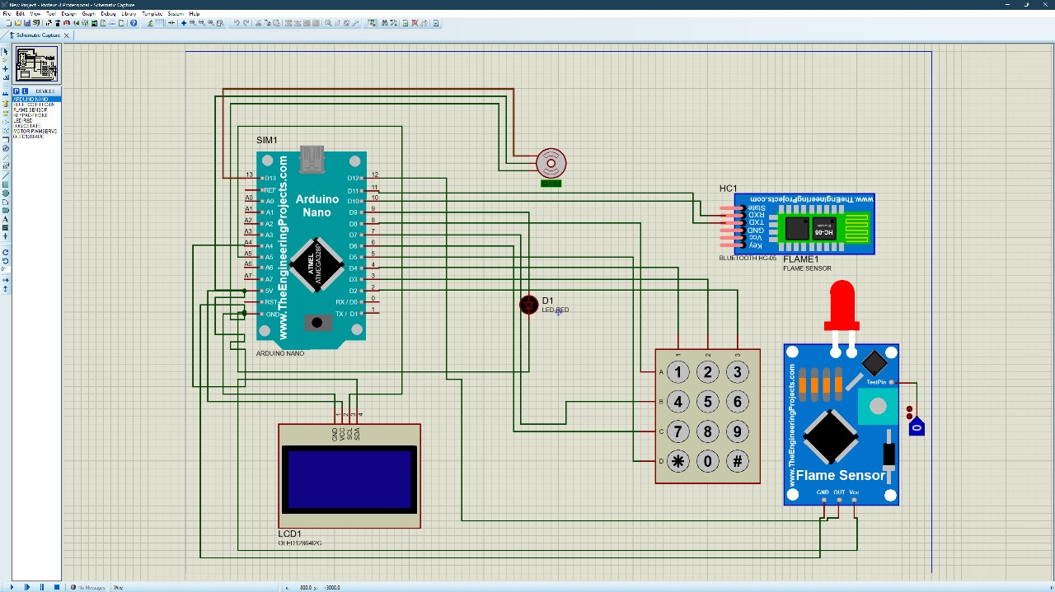
Research/Working Method
Circuit designed in simulation software
Components connected virtually (Arduino, sensors, modules)
Code uploaded to simulated Arduino
Flame input simulated as HIGH/LOW signal
LED response observed in simulation
Servo rotation tested in software
Bluetooth and keypad logic verified through serial monitor
Figure 2:Simulation of the Circuit

Slide 12
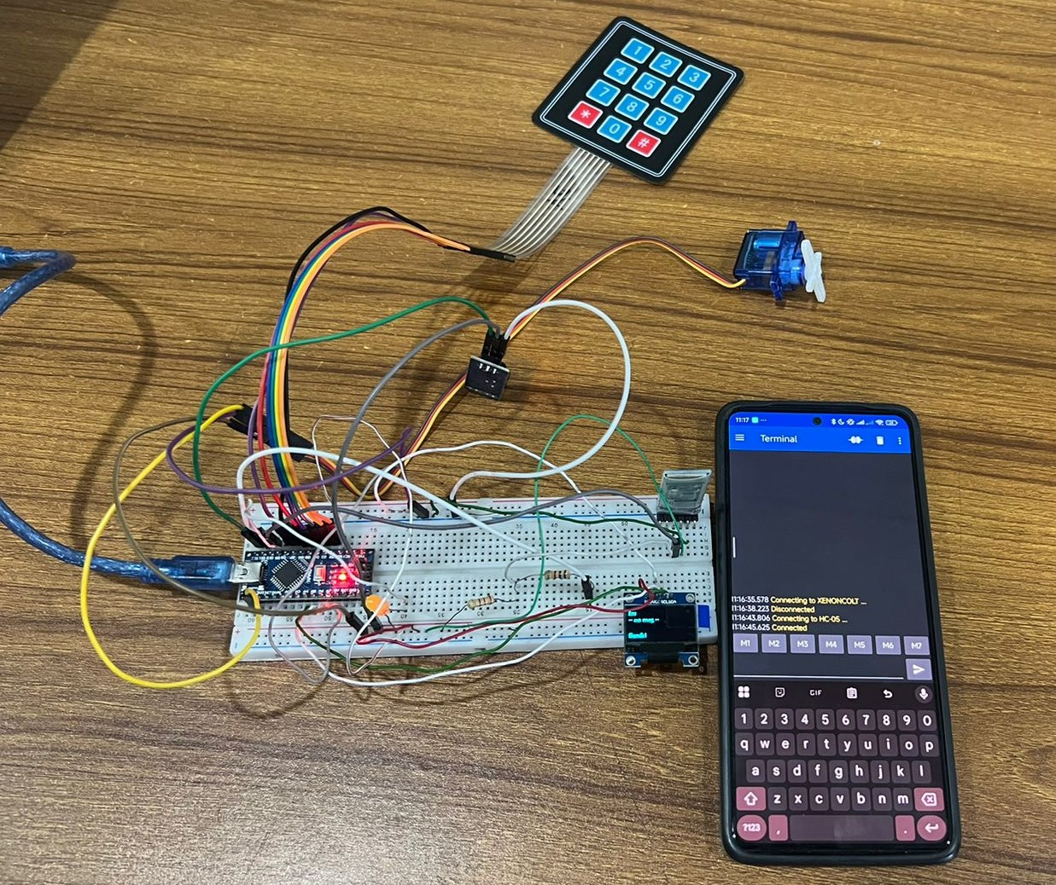
Description/Methodology of the Work
Flame detected by sensor
Signal processed by Arduino Nano LED blinks as alert
Servo motor activates as pump
Bluetooth enables phone control
Keypad sends/receives commands
OLED displays system status

Slide 13

Equations/Mathematical Model
1. Flame Sensor ADC Value
The flame sensor outputs an analog voltage $V_{sensor}$, which the Arduino converts to a digital ADC value:
ADC Value=$\frac{V_{sensor}}{Vref}$×1023
Sample Calculation:$V_{sensor}=2.5 \text{V}$,$V_{ref}=5 \text{V} \text{Now}\text{, }\text{ADC} \text{Value}=\frac{2.5}{5}×1023=511.5≈512$
2. LED Blink Frequency
LED blink frequency $f$is determined by ON and OFF time: $f=\frac{1}{T_{on}+T_{off}}$
Sample Calculation:$T_{on}=0.5 \text{s}, T_{off}=0.5 \text{s}$ Now, $f=\frac{1}{0.5+0.5}=1 \text{Hz}$
3. Servo Motor Angle
Servo angle $θ$is proportional to PWM pulse width $t_{pulse}$: $θ=\frac{t_{pulse}−1 \text{ms}}{1 \text{ms}}×{180}^{∘}$
Sample Calculation: $t_{pulse}=1.5 \text{ms}$ ,Now $θ=\frac{1.5−1}{1}×180={90}^{∘}$
Result: Servo rotates 90° to open water valve.

Slide 14
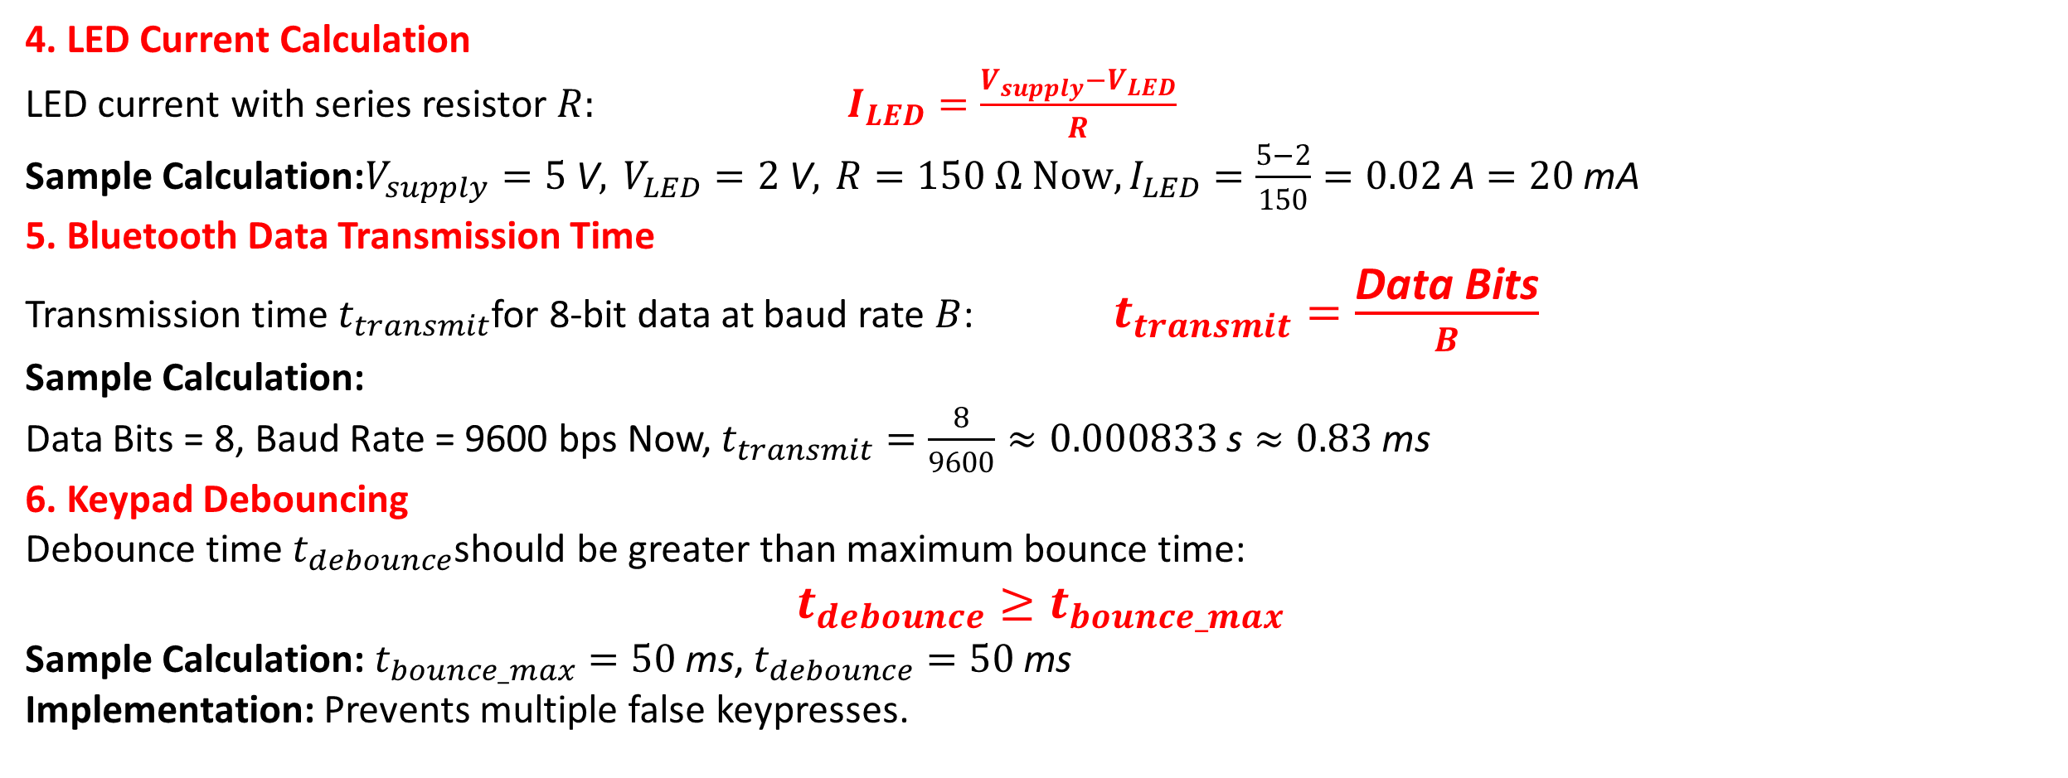
Equations/Mathematical Model
4. LED Current Calculation
LED current with series resistor $R: I_{LED}=\frac{V_{supply}−V_{LED}}{R}$
Sample Calculation:$V_{supply}=5 \text{V}, V_{LED}=2 \text{V}, R=150 Ω Now,I_{LED}=\frac{5−2}{150}=0.02 \text{A}=20 \text{mA}$
5. Bluetooth Data Transmission Time
Transmission time $t_{transmit}$for 8-bit data at baud rate $B$: $t_{transmit}=\frac{\text{Data} \text{Bits}}{B}$
Sample Calculation:
Data Bits = 8, Baud Rate = 9600 bps Now, $t_{transmit}=\frac{8}{9600}≈0.000833 \text{s}≈0.83 \text{ms}$
6. Keypad Debouncing
Debounce time $t_{debounce}$should be greater than maximum bounce time:
$$t_{debounce}≥t_{bounce_max}$$
Sample Calculation: $t_{bounce_max}=50 \text{ms}$, $t_{debounce}=50 \text{ms}$
Implementation: Prevents multiple false keypresses.

Slide 15
Survey Report
A sample survey report

Slide 16
Survey Report

Slide 17
Survey Report

Slide 18
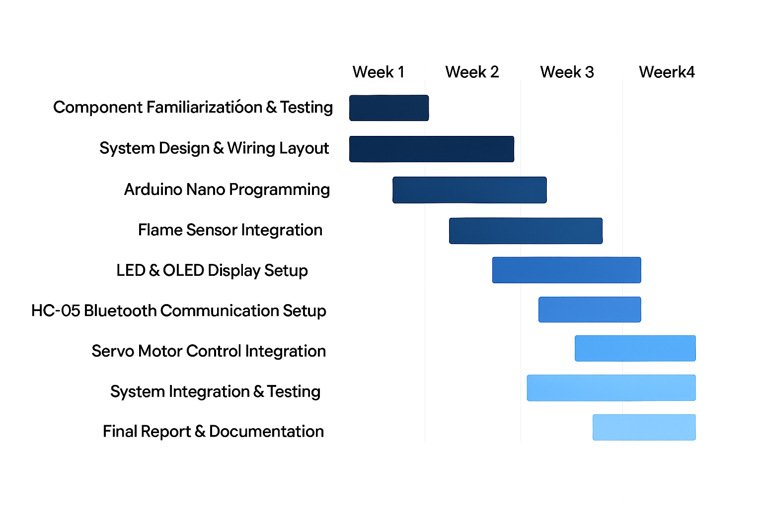
Gantt Chart

Slide 19
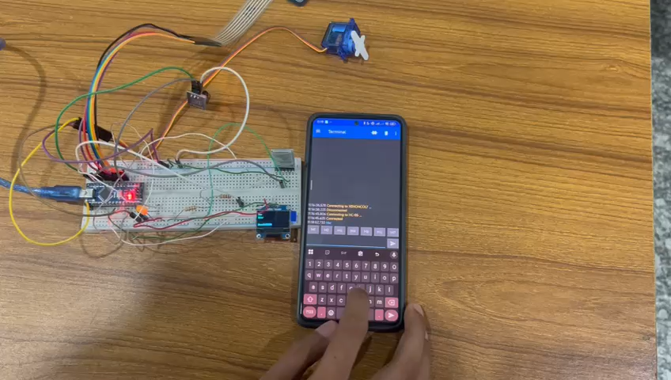
Outcomes/Results and Discussions
Project Demonstration

Slide 20
:
Outcomes/Results and Discussions
💬
Outcomes/Results
Flame sensor detected fire accurately within 1 meter.
LED alert activated instantly upon detection.
Servo motor rotated to spray direction as programmed.
OLED displayed real-time system status.
HC-05 enabled wireless control and monitoring.
Keypad allowed manual override and servo control.
Discussion
System responded quickly and reliably.
Power usage was low (~1.58W), suitable for portable use.
Bluetooth and OLED improved user interaction.
Detection accuracy dropped in bright sunlight.
Our system adds wireless control and display—missing in earlier works.

Slide 21
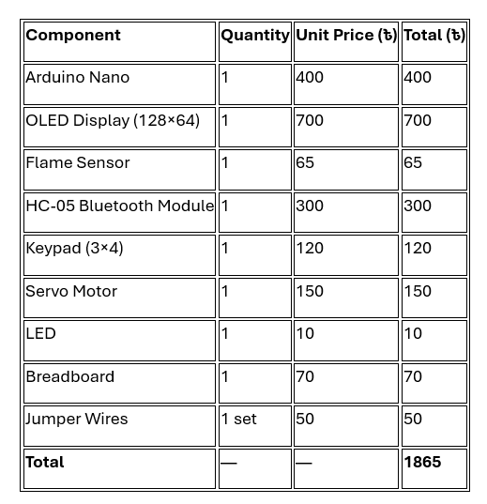
Outcomes/Results and Discussions
The following table represents the cost analysis of the components required for the proposed fire detection and response system. The total cost of implementation was estimated to be 1865 Taka.

Slide 22
Conclusions
In conclusion, the Arduino-based flame detection system was successfully designed and implemented, integrating key components such as a flame sensor, LED alert, servo-driven water control, HC-05 Bluetooth module, OLED display, and keypad interface. The system demonstrated reliable flame detection, responsive actuation, and effective user interaction through both manual and wireless control. Its low power consumption and real-time feedback capabilities make it suitable for safety-critical applications, while improvements over previous works—such as enhanced communication and display features—highlight its practical value and innovation.

Slide 23
Future Scopes
Upgrade flame sensor for wider detection range and better sunlight resistance.
Develop mobile app interface for Bluetooth control and status monitoring .
Integrate battery backup for uninterrupted operation during power failure .
Add Wi-Fi module for cloud-based alert and remote access .
Include buzzer for audible fire alert alongside LED .
Implement data logging for fire event tracking and analysis .
Explore AI-based fire pattern recognition for smarter response .
Expand system for multi-room fire detection in smart home setups .

Slide 24
Thanks for listening our presentation….
?

